Slide 1
Marketing analysis of Pay-per-use model
Global
Storage Industry and Marketing Insights
Using HPE Greenlake as an example

Slide 2
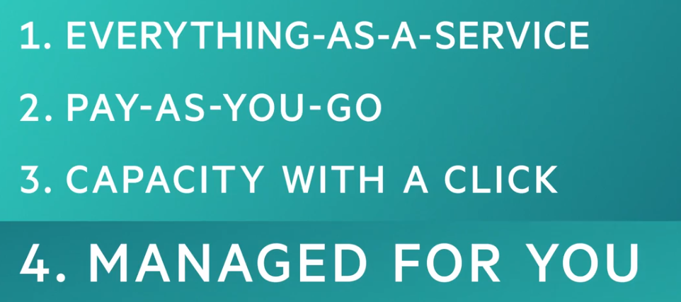
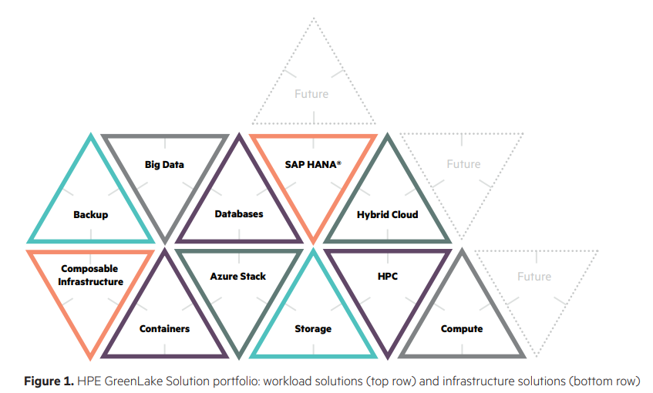
What is Greenlake?
Greenlake is HPE’s enterprise supported solution to offer customers a pay as you go environment. It aims to compete with not only traditional IT vendors but also public cloud vendors and hybrid cloud providers.
Covers a broad range of services needed by enterprises, from database to big data, from storage to HPC.

Slide 3
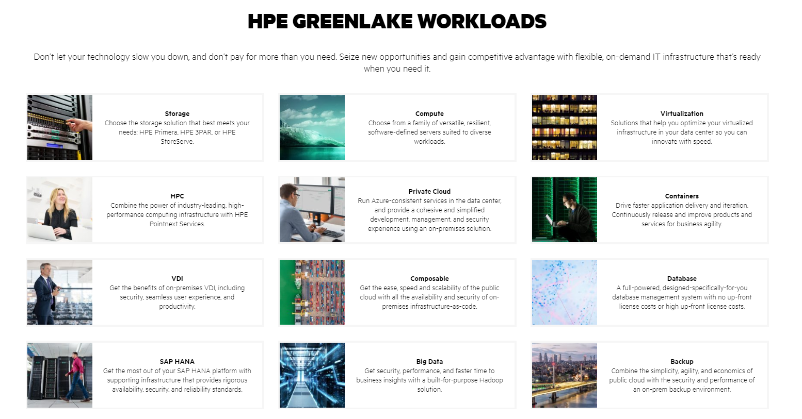
Covers a broad range of workloads…
Source: www.hpe.com/us/en/greenlake.html

Slide 4
















Why did customers choose Greenlake?
and ease the customer’s concern of vendor lock in.
Ecosystem
$2.8 billion in total contract value,
and over 600 customers
HPE plays a service provider role.
It aims to solve two pain points,
Cost saving
Ease of use and management
EVERYTHING is metered!
Professionally managed!
Not paying for unused resources.
Single vendor covers all.
Consumption analytics
Visibility/control/capacity planning
Storage consumed
Interactive charts/graphs (insight)
Automate capacity planning
Single vendor support for public and private clouds
Pay as you go, consume-based IT
HPE pointnext services, infrastructure as code.
HPE adaptive management services.

Slide 5

Key technology innovations
Acquired by HPE in 2017 to bolster the metering capability
Consumption analytics
In each components:
Storage
Servers
Container orchestration
In solution level:
Composable infrastructure
Extremely important and key in Pay-per-use model

Slide 6

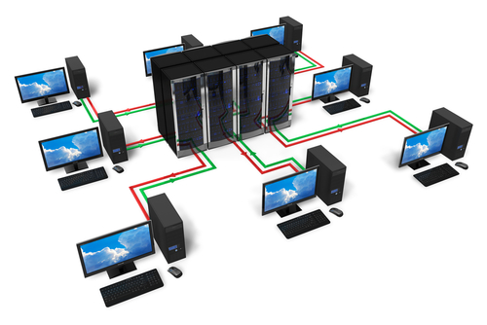





Pay-U-model components
User
Budgeting and
Metering service
Data center services
Billing
System Administration service
Public cloud services
Managed service team

Slide 7
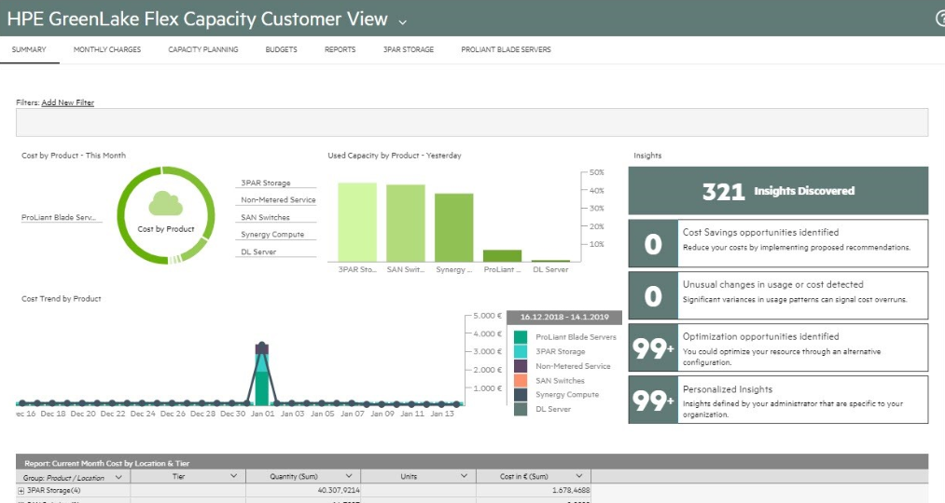
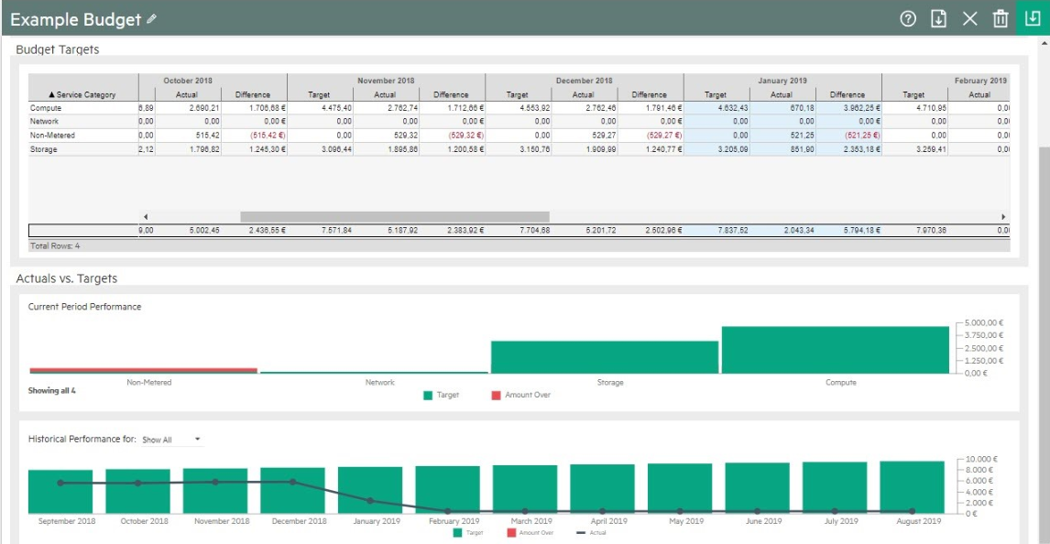
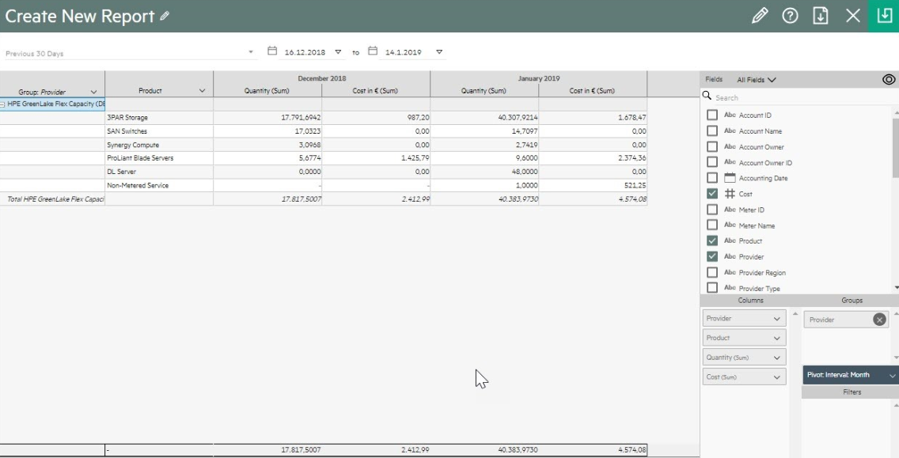
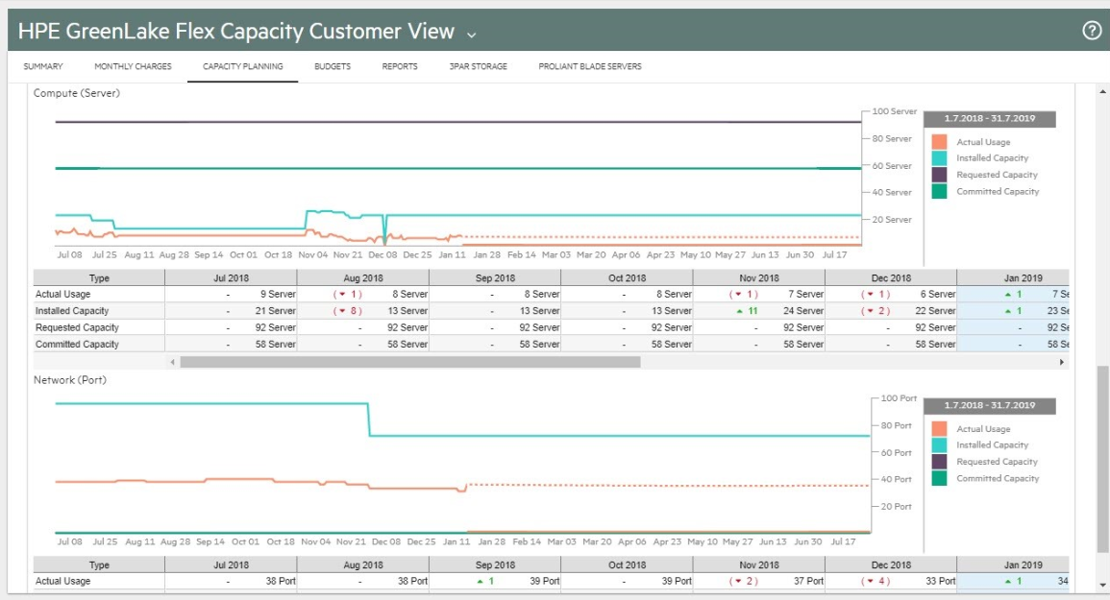
Transparent to customers. Work closely with Account Service Manager (ASM) to add/reduce capacity.
Source: https://community.hpe.com/t5/the-cloud-experience-everywhere/consumption-based-it-just-got-even-better/ba-p/7031550

Slide 8








Cloud Cost optimization with tools
Why the tools provided by cloud vendors are not enough?
Not the top priority for public cloud vendors.
Multi-cloud support.
Needs customer usage knowledge and need integration and customization.
Many hybrid cloud use cases beyond public cloud vendor’s view.
FinOps foundation (http://finops.org)
Many small/mid-size companies are filling the gap.

Slide 9
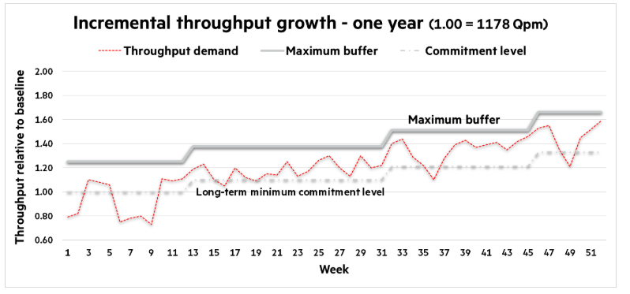
Business model innovations – A win-win strategy
Auto-provisioned by HPE
Billed based on committed usage
Actual usage
Committed usage for basic contract
Max(actual usage, committed usage)
Actual charge
(Billed)
https://community.hpe.com/t5/ai-insights/comparing-hpe-on-premises-infrastructure-vs-amazon-web-services/ba-p/7019674#.XsWNbmhKiXI
HPE is seeing on average a 22 – 30 percent cash flow savings with customers adopting the GreenLake model
https://www.crn.com/slide-shows/channel-programs/300106216/5-reasons-hpe-greenlake-is-a-hit.htm

Slide 10
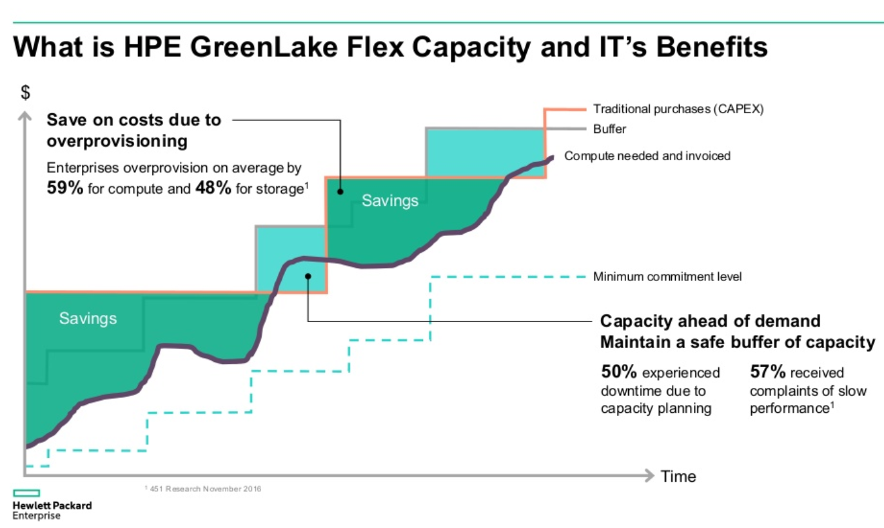
Source: “Delivering everything as a service”, https://www.slideshare.net/LizMastersLovelace/43019-hpe-greenlake-and-cloud-technology-partners-ctp

Slide 11
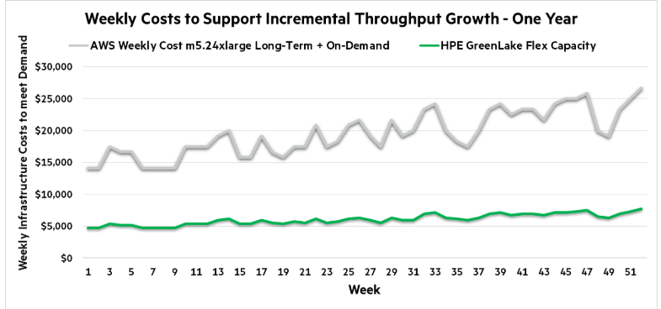
Cost savings passed to customers
Agility increased. 65%
Customers get faster procurement. Compared to 90 days previously.
Ahead of the procurement cycle.
3 times cheaper than AWS in this case.
https://community.hpe.com/t5/ai-insights/comparing-hpe-on-premises-infrastructure-vs-amazon-web-services/ba-p/7019674#.XsWNbmhKiXI

Slide 12
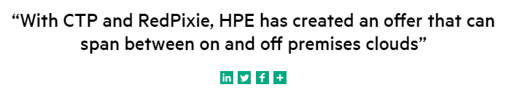
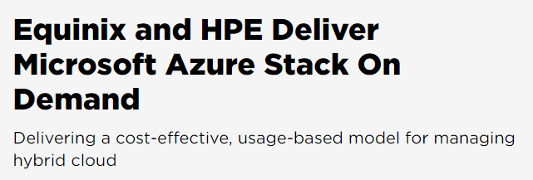
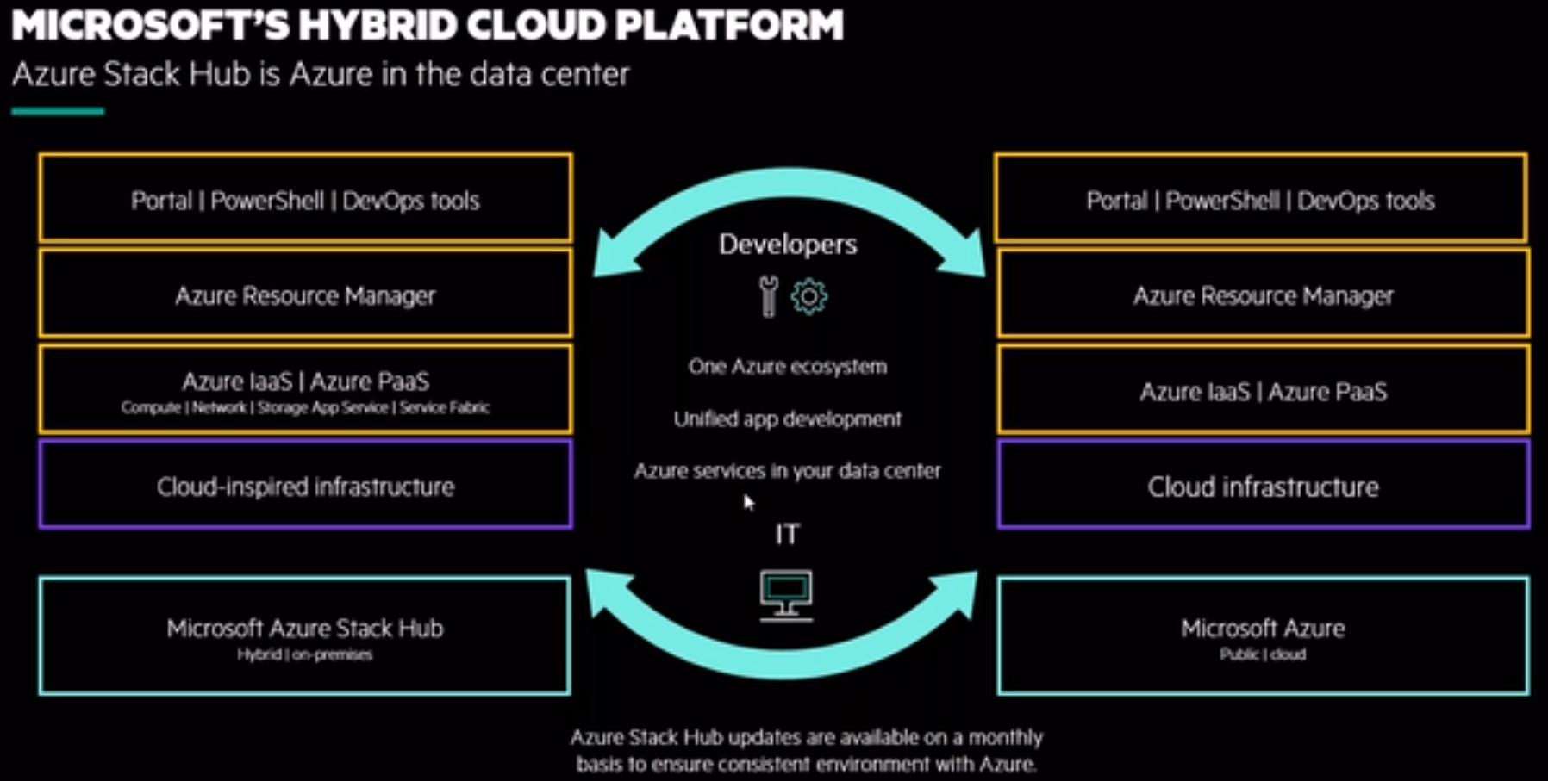
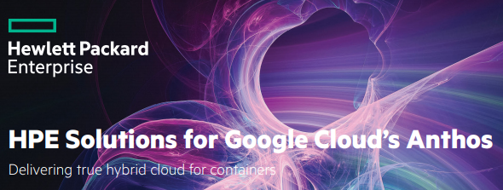
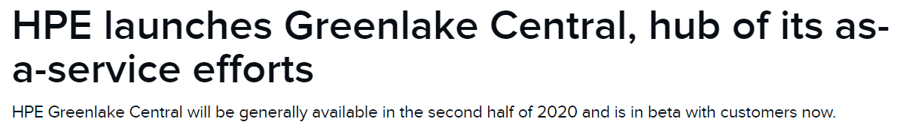
Hybrid cloud ecosystem
Azure stack

Slide 13

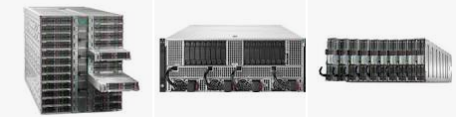
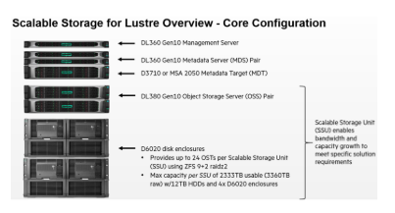
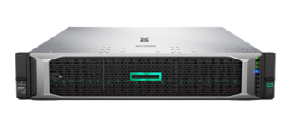
ADAS simulation solutions
HPE Apollo servers
Greenlake
HPE Proliant servers
Sources: https://www.businesswire.com/news/home/20200121005252/en/Zenuity-Hewlett-Packard-Enterprise-Join-Forces-Develop

Slide 14
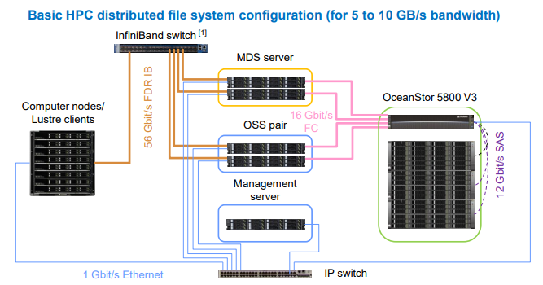
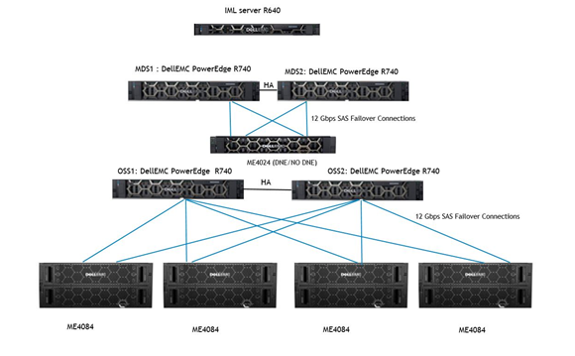
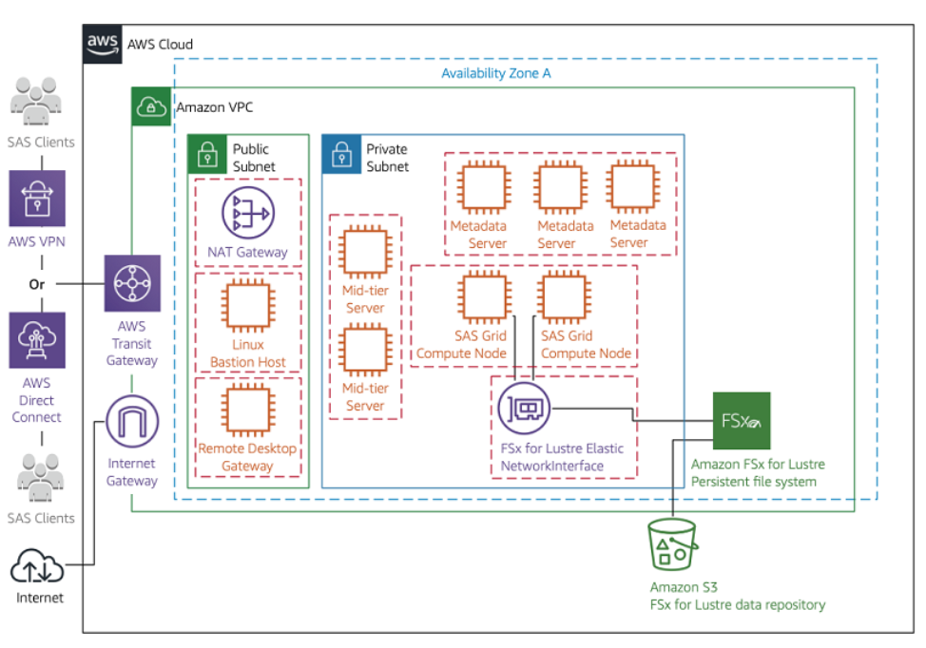
Other industrial vendors of Lustre FS for HPC simulations.
Huawei
Dell
AWS FSx
Sources:
1.https://actfornet.com/HUAWEI_STORAGE_DOCS/53555658V3/Huawei%20OceanStor%20V3%20HPC%20Distributed%20File%20System%20Reference%20Architecture%20(Brochure).pdf
2. https://www.dell.com/support/article/en-us/sln314777/dell-emc-ready-solution-for-hpc-lustre-storage-using-powervault-me4-storage-line?lang=en#Solution
3. https://aws.amazon.com/blogs/big-data/running-a-high-performance-sas-grid-manager-cluster-on-aws-with-amazon-fsx-for-lustre/

Slide 15
Target marketing segments
“Mid-market”, enterprises that do not have their own data center facility or lack IT staff to set up and manage infrastructure, applications, and workloads.
Average Deal is 4 years.
HPE is turning into an IT service provider. Partnering with Equinix and CyrusOne (data center providers) and Google cloud to turn everything into a service.
But with customer’s Choice, Flexibility, and Control (aka Customized Services)
Use pre-configured systems but with automated optimization to fit user needs.
https://www.hpe.com/us/en/newsroom/press-release/2019/06/hpe-announces-plans-to-offer-entire-portfolio-as-a-service-by-2022.html
https://www.crn.com/slide-shows/channel-programs/300106216/5-reasons-hpe-greenlake-is-a-hit.htm

Slide 16
Pay-U Strategy
Show a reliable pay-per-use and provider -managed service program.
01
Show realistic and convincing dollar amounts that indicate cost savings, from other providers.
02
Improve the easy-to-use and agility factors.
03

Slide 17
Thank you!

